Slide 1

A PROJECT PRESENTATION
On
Comparative Study of Different Algorithms for Heart Disease Prediction
By
Atreyee Joardar - 2106020
Dipayan Goswami - 2106026
Rion Sutradhar - 2106051
Syamantak Dutta - 2106271
UNDER THE GUIDANCE OF
Dr. Siddharth Swarup Rautaray
SCHOOL OF COMPUTER ENGINEERING
KALINGA INSTITUTE OF INDUSTRIAL TECHNOLOGY
BHUBANESWAR, ODISHA - 751024

Slide 2
Contents
Introduction
Problem statement
Dataset used
General Approach
Methodology of K-Nearest Neighbour
Methodology of Support Vector Machine
Methodology of Random forest
Methodology of Logistic regression
Training and Testing Accuracy
Confusion matrix
Evaluation Metrics
ROC curve
PR curve
Results
Conclusion and Future Scope

Slide 3
Introduction
Heart Disease is the Leading cause of deaths in India.
Indian Council of Medical Research (ICMR) suggested that 60% of non-communicable diseases (NCDs) deaths in India are because of Heart Disease.
The World Health Organization (WHO) reports that cardiovascular diseases claim over 1.7 million lives in India annually
Predicting Heart Disease with the use of ML model holds immense potential; for preventive healthcare.
It helps in improved treatment efficiency, reduced healthcare costs and enhances patient well-being.
Refining the accuracy of models is the leading field of research in India as Machine Learning continues to evolve and healthcare data becomes more comprehensive and easily available.

Slide 4
2. Problem Statement
Our problem is that we are going to determine a machine learning model that predicts whether a patient is suffering from heart disease or not, using the a publicly available dataset. We will apply four different machine learning algorithms (KNN, Logistic Regression, Random Forest and SVM) to the dataset and evaluate their performance using various metrics like precision, recall, F1 score etc. We will then compare these algorithms based on the calculated metrics and determine which one yields the most optimal and accurate predictions for detecting heart disease. This approach allows us to assess the effectiveness of each algorithm in identifying patients at risk. By comparing their performance, we can choose the one that delivers the most accurate and reliable results in a clinical setting. Additionally, this analysis helps optimize resource allocation by determining which algorithm requires fewer resources or performs better with available data. Furthermore, evaluating multiple models ensures the generalizability of the chosen model, meaning it can be applied to unseen data or different patient populations. Ultimately, this comprehensive analysis informs decision-making, guiding the selection and deployment of the most effective heart disease prediction tool, potentially leading to earlier diagnoses, better patient outcomes, and improved healthcare efficiency.

Slide 5
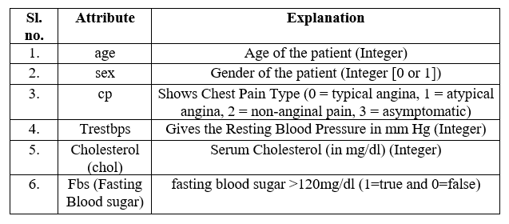
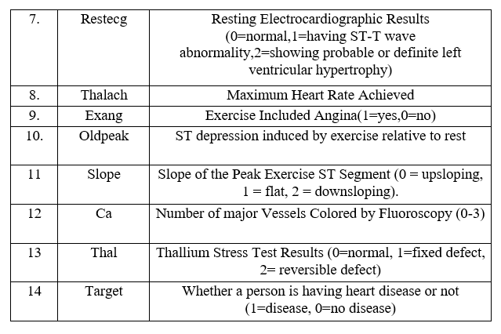
3. Dataset Used
Table 3.1. Dataset Description
The dataset being publicly available removes the barrier for researchers and allows for widespread experimentation and analysis. This nurtures collaboration and helps build upon existing knowledge. The dataset has a standardized format with consistent features which enables the researchers to easily compare their findings across different studies, ensuring replicability and facilitating the development of robust models. The dataset offers a clear target variable: the presence or absence of heart disease. This characteristic makes it suitable for supervised machine learning tasks, specifically classification problems where algorithms learn to categorize new data points based on existing labeled examples. It is large enough to train model but not so large that computational resources become a major problem.

Slide 6
Methodologies

Slide 7
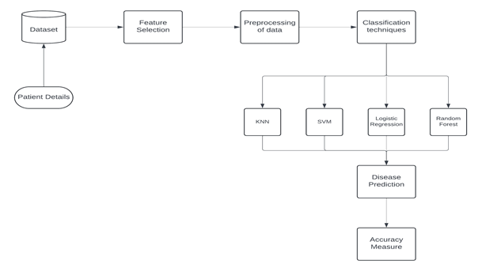
4. General Approach
In Fig. 4.1, the patient details are collected in the dataset by various data mining techniques and historical data. Patient data are mostly of high volume, high variety and high velocity and are stored in a dataset in a structured form. Important features which are the most effective towards the target variable which in this case is heart disease prediction are chosen and kept. After that various data pre-processing methods are applied and then a classification technique is chosen. According to the chosen classification technique, accuracy will vary and we will get different results.
Fig. 4.1. A Flowchart that depicts the data flow and how at each stage it is handled to get the prediction

Slide 8
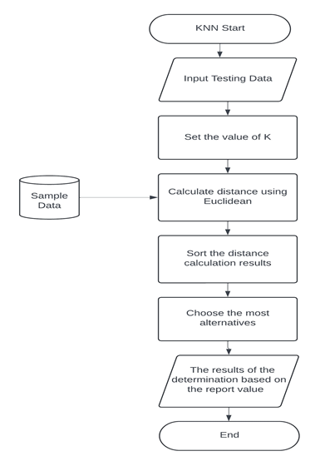

5. K-Nearest Neighbour
In Fig. 5.1, the working of the KNN algorithm is illustrated. The algorithm begins and then in the next step, test dataset is fed into the algorithm. Next, the user specifies the number of neighbours (K) to consider when making a prediction. Now, the distance between the test data point and each data point in the training data set using the Euclidean distance formula given by eq. (5.1) as
(5.1)
Next, once the distances are calculated, they are then sorted in ascending order and the algorithm then chooses the most common class among the K nearest neighbors. Now, according to the majority vote of its K nearest neighbors, the final classification of the test data point is decided.
Fig. 5.1. A Flowchart that depicts how the KNN algorithm works

Slide 9
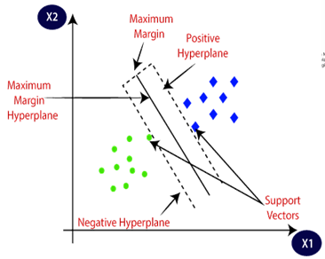
6. Support Vector Machine
The Support Vector Machine is a model that attempts to separate different classes using a hyperplane that has the highest margins between the supports. By supports, we mean the points that are closest to the other classes. These supports are used by the hyperplane to measure the shortest perpendicular distance from the support to the hyperplane which is minimized by figuratively “rotating” the hyperplane to get the maximum margins, i.e. the maximum distance between the supports. Fig. 6.1, explains the aforementioned concept properly, where a hyperplane is separating Class A (Green points) and Class B (Blue points) points using maximum distance between the supports. This machine learning model is also used for regression and is called the “Support Vector Regressor” (SVR).
Fig. 6.1. Demonstration of working of SVM in separating two classes

Slide 10
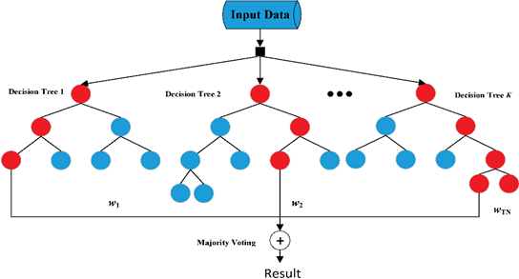
7. Random Forest
Random Forests may be seen as an extension to the Decision Tree because it comprises many decision trees that are individually and randomly initiated. This is called a bagging approach where many individual estimators are applied to find a solution which is averaged from each estimator. This can be shown in Fig. 7.1. It is mentioned in the Scikit-Learn documentation that the Random Forest that their implementation of the Random Forest does not individually vote for each class and take the averages, rather, the model takes the averaged probabilities of all the classes and predicts the one that has the highest average probability.
Fig. 7.1. Random Forest having K decision Trees

Slide 11

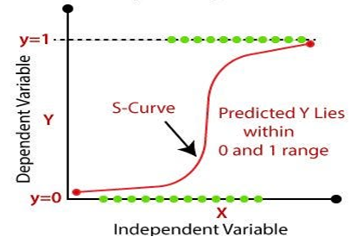
8. Logistic Regression
While it has “regression” in its name, Logistic Regression is actually used for classification. To describe the probabilities of trials, the model uses a logistic function that is given by eq. (4.2.). In eq. (4.2), 𝑧 is a linear model that is converted into a logistic model using the Logit function. Using Logistic Regression, the values lying on the logistic curve are thresholded to 0 or 1 depending upon the threshold value (which is usually 0.5). The S-shaped curve in Fig. 8.1, also called the sigmoid curve, represents the predicted probability. The horizontal axis (X) represents the independent variable and the vertical axis (Y) represents the predicted probability, which can range from 0 to 1. As the value of the independent variable increases, the probability (represented by the S-curve) goes from 0 to 1, asymptotically approaching these values.
(8.1)
Fig. 8.1. Random Forest having K decision Trees

Slide 12
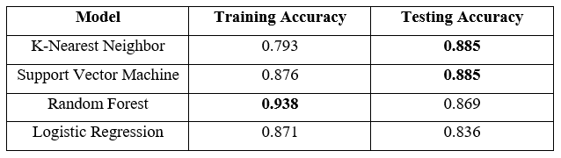
9. Training and Testing Accuracy
Here in Table 9.1, we see that KNN and SVM both have the best testing accuracy but we also have to see that comparative to other algorithms SVM has the least difference between Training and Testing accuracy suggesting a more general fit while others tending towards overfitting or underfitting. Although we will not base our conclusion on accuracy alone as it can be misleading. Next, we will look deeper with the use of confusion matrices and various other evaluation matrices.
Table 9.1. Training and Testing Accuracy of each dataset

Slide 13
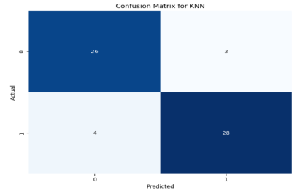
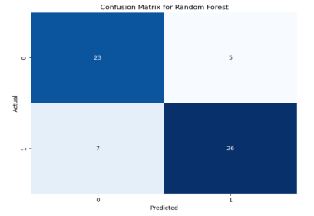
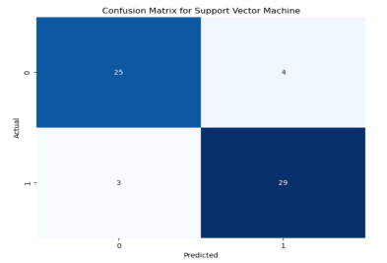
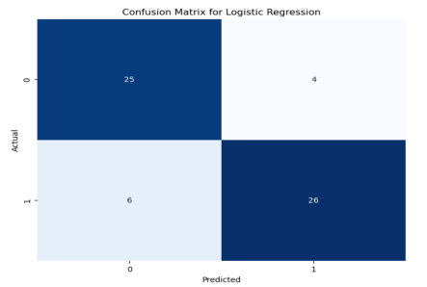
10. Confusion Matrix

Slide 14
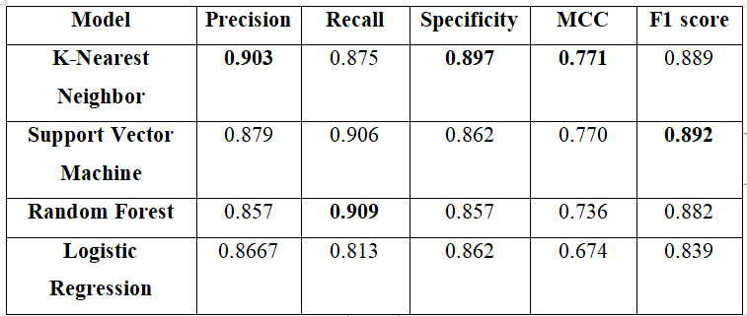
11. Evaluation metrics
In Table 11.1, we should be prioritizing algorithms with higher recall as false negatives (Person does have heart disease but model predicts that he doesn’t have it) are much costlier than false positives (Person does not have heart disease but model predicts that he does have it). We see that Random Forest has the highest recall. Now, higher precision and higher specificity will ensure that there are minimal false positives (Person does not have heart disease but model predicts that he does have it). We see that KNN has both highest precision and specificity. Higher MCC means a good balance between True Positive (Person does have heart disease and model correctly predicts it), True Negative (Person does not have heart disease and model correctly predicts it), False Positive (Person does not have heart disease but model predicts that he does have it) and False Negative (Person does have heart disease but model predicts that he doesn’t have it). KNN has the highest MCC. Higher F1 score means a good balance between precision and recall. SVM has the highest F1 score. Now we clearly see that KNN is performing better. We will look deeper into it by analyzing ROC and PR curves.
Table. 11.1. Evaluation Metrics for each model

Slide 15
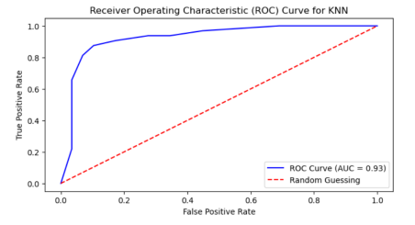
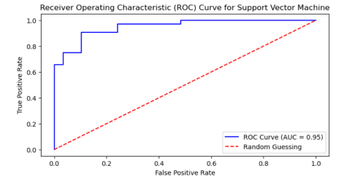
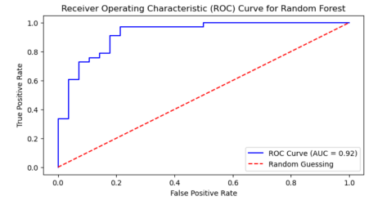
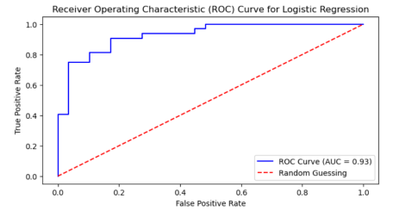
12. ROC Curve
As we can see, SVM has the highest AUC (Area under curve) which does tell us that it performs better. Now let’s look into the PR curves.

Slide 16
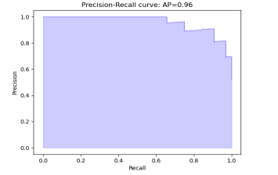
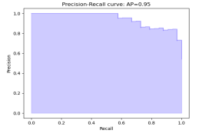
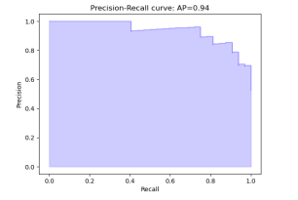
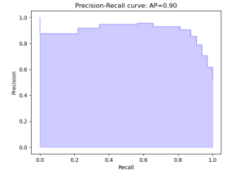
13. PR Curves
We see that for SVM, the average precision is the highest and we also see that that in SVM the curve hugs the most to the top right corner, so we conclude that SVM has a good performance and a very good balance between precision and recall.
Fig. 13.1. PR curve for SVM
Fig. 13.2. PR curve for Random Forest
Fig. 13.3. PR curve for Logistic regression
Fig. 13.4. PR curve for KNN

Slide 17
14. Results
Now if we assign points to every time an algorithm performs the best in a particular metric, we see that:
Logistic Regression scores 0 points and it performs poorly for every metric.
Random Forest scored 2 points with very good recall and a good training accuracy. It is observed that Random Forest tends to overfit as it has a good Training accuracy but falls short on Testing accuracy.
KNN and SVM both scored 4 points. Both have good testing accuracy. Where they differ is that KNN is a better algorithm if the requirement is to predict equally for all cases i.e., TP, FP, TN, FN as it has better MCC. SVM has better balance between Precision and Recall that means it will prioritize more to minimizing FP and FN.
Hence, with this project of comparing different machine learning and data mining techniques for the prediction of heart disease, we conclude that SVM works the best with the given dataset.

Slide 18
15. Conclusion and Future Scope
Our study explored the efficacy of various machine learning algorithms in predicting heart disease, namely KNN, SVM, Random Forest, and Logistic Regression. It was observed that SVM emerged as the most promising model, exhibiting superior performance in terms of accuracy, precision, and recall. This suggests its potential as a robust tool for heart disease prediction. This suggests its potential as a robust tool for heart disease prediction.
Some Future Scopes:
Incorporating Advanced Feature Selection Techniques
Exploring Ensemble Methods
Integration of Emerging Technologies
Conducting Longitudinal Studies
Development of User-Friendly Interfaces

